Slide 1
PACKET SNIFFER
Our project focuses on capturing and analyzing packets of data that flow through a particular network.

Slide 2
Packet sniffers are used to troubleshoot and rectify network-related problems.
Monitoring network usage
Detection of clear text passwords and usernames from the network.
Detecting security loopholes
Performance analysis to discover network bottlenecks
Conversion of data to human readable format so that people can read the traffic

Slide 3
Working Procedure with algorithm
When a packet sniffer is installed in the network, the sniffer intercepts the network traffic and captures the raw data packets.
Subsequently, the captured data packet is analyzed by the packet sniffing software and presented to the network manager/technician in a user-friendly format.

Slide 4
Here, we used the python network programming library “socket” to intercept the network traffic
We then have written user-defined functions to unpack the data, format the data, fragment and assign the values of respective data packet

Slide 5
How the code works:
Sniffing
Read the captured packet
Analyse it
Present it to the user in a readable format.

Slide 6
Implementation:
We have implemented the above described working procedure using the following library and functions:-
socket()
ethernet_frame(data)
ipv4_Packet(data)
icmp_packet(data)

Slide 7
tcp_seg(data)
udp_seg(data)
get_mac_addr(bytes_addr)
ipv4(addr)
format_output_line(prefix, string, size=80)

Slide 8
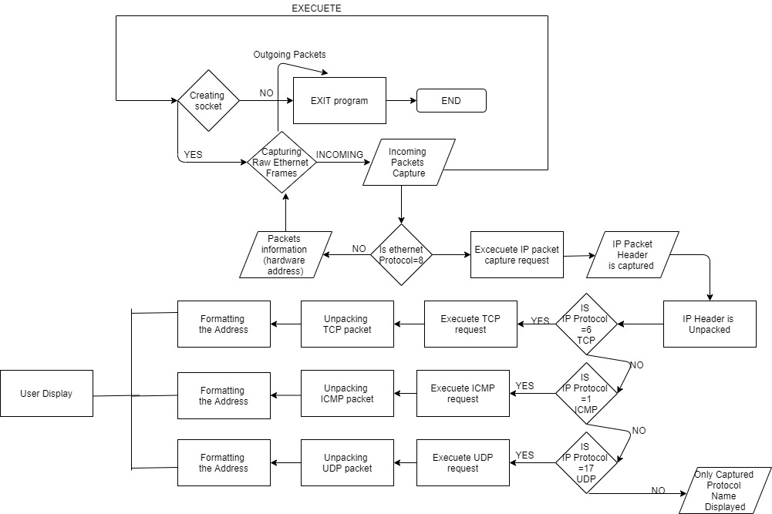

Slide 9
Results
We have implemented a packet sniffer which can
sniff TCP UDP ICMP and IPV4 packets being transmitted on the same network, by sniffing every packet by its domain structure and
unpacking it accordingly and
presenting to the user in a readable format by formatting the data packet.

Slide 10
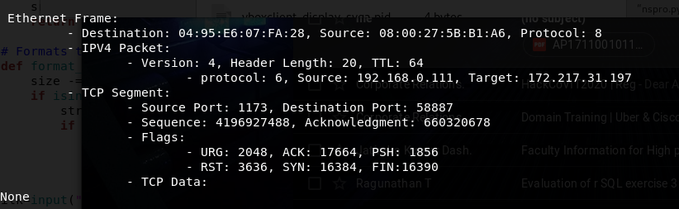
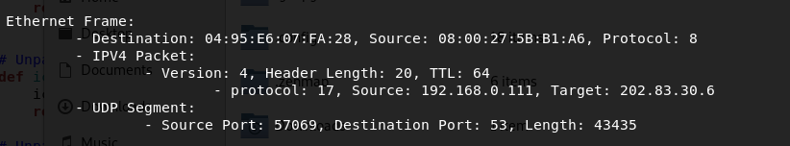

Slide 11
Thank You.

